Slide 1
Applied Cryptography Data Encryption Standard (DES)
Liangfeng Zhang
School of Information Science and Technology
ShanghaiTech University

Slide 2
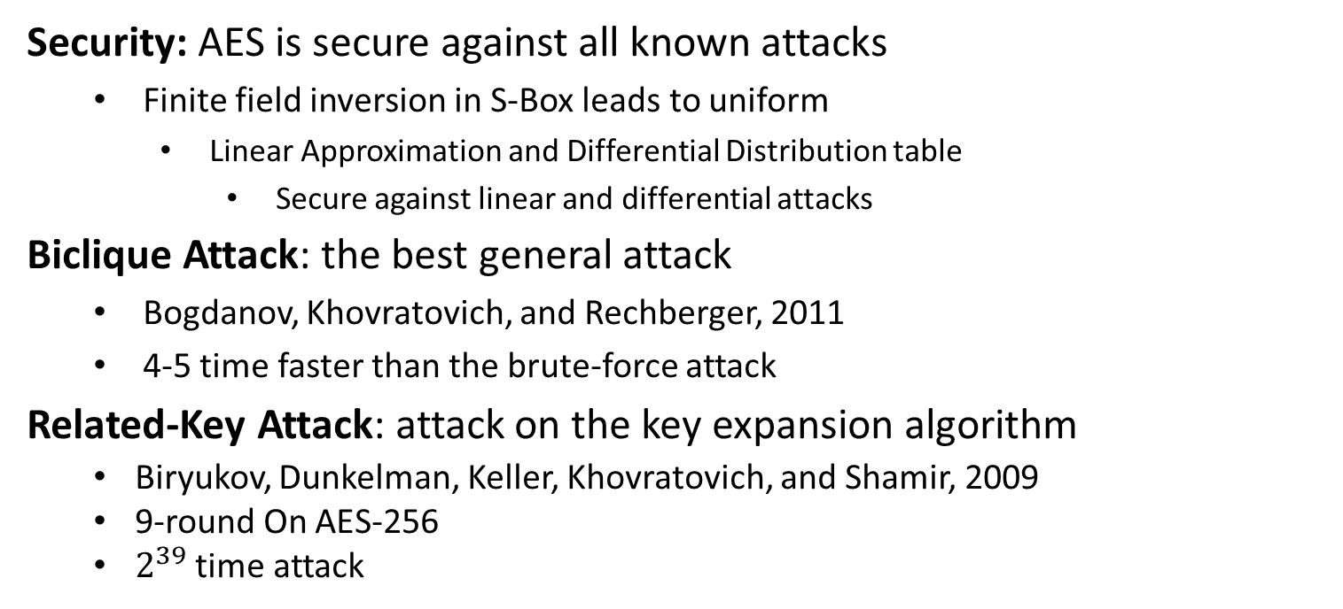
Analysis of AES
Security: AES is secure against all known attacks
Finite field inversion in S-Box leads to uniform
Linear Approximation and Differential Distribution table
Secure against linear and differential attacks
Biclique Attack: the best general attack
Bogdanov, Khovratovich, and Rechberger, 2011
4-5 time faster than the brute-force attack
Related-Key Attack: attack on the key expansion algorithm
Biryukov, Dunkelman, Keller, Khovratovich, and Shamir, 2009
9-round On AES-256
$2^{39}$ time attack

Slide 3
The History of DES
1970s: Horst Feistel (German) designed Lucifer at IBM
key length: 128 bits; block length: 128 bits
05/15/1973: NBS published a solicitation for cryptosystems.
NBS: National Bureau of Standards (1901-1988)
NIST: National Institute of Standards and Technology (1988- now)
08/27/1974: A second request was issued; IBM submitted one, which was adopted from Lucifer and later called DES (Data Encryption Standard).
key length: 56 bits; block length: 64 bits; number of rounds: 16
03/17/1975: DES was first published in the Federal Register.
01/15/1977: DES was adopted as a standard
1997: DES was broken by exhaustive search
key length is too small
10/02/2000: Rijndael was selected as AES by NIST

Slide 4

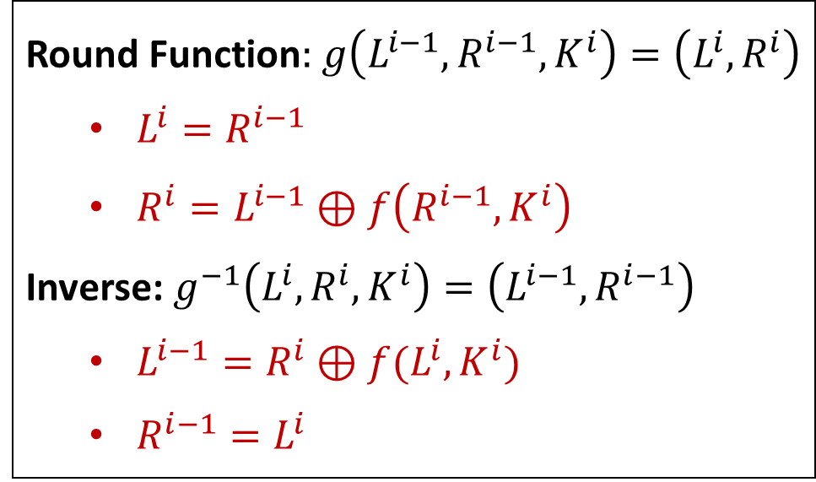





Feistel Network
$$L^{i−1}$$
$$R^{i−1}$$
Round Function$:$ $g\left(L^{i−1},R^{i−1}, K^{i}\right)=\left(L^{i},R^{i}\right)$
$L^{i}=R^{i−1}$
$R^{i}=L^{i−1}⊕f\left(R^{i−1}, K^{i}\right)$
Inverse: $g^{−1}\left(L^{i},R^{i}, K^{i}\right)=\left(L^{i−1},R^{i−1}\right)$
$L^{i−1}=R^{i}⊕f(L^{i},K^{i})$
$R^{i−1}=L^{i}$
$$f$$
$$K^{i}$$
$$L^{i}$$
$$R^{i}$$

Slide 5





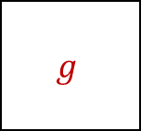















DES Encryption
$56$-bit
secret key $K$
key schedule
$48$-bit
$$K^{1}$$
$$K^{2}$$
$$⋯$$
$$K^{16}$$
$$g$$
$$g$$
$$g$$
$$x$$
$$IP$$
$$⋯$$
$$SW$$
$$IP^{−1}$$
$$y$$
$$L^{0},R^{0}$$
$$L^{1},R^{1}$$
$$L^{2},R^{2}$$
$$L^{16},R^{16}$$
$64$-bit
$64$-bit

Slide 6
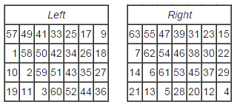
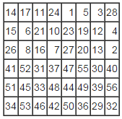









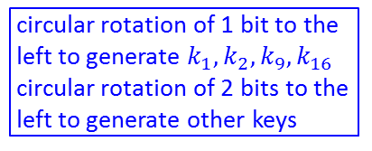









Key Schedule
64-bit key $k$
$$PC1$$
PC1
circular rotation of 1 bit to the
left to generate $k_{1},k_{2},k_{9},k_{16}$
circular rotation of 2 bits to the
left to generate other keys
28-bit
28-bit
<
<
28-bit
28-bit
PC2
48-bit $K^{1}$
<
<
28-bit
28-bit
PC2
48-bit $K^{2}$
64-bit $k→$ 56-bit $K$
<<
<<
$$PC2$$
28-bit
28-bit
PC2
48-bit $K^{3}$
$$⋮$$
$$⋮$$
$$⋮$$
$$⋮$$
<
<
28-bit
28-bit
PC2
48-bit $K^{9}$
<<
<<
28-bit
28-bit
PC2
48-bit $K^{10}$
$$⋮$$
$$⋮$$
$$⋮$$
$$⋮$$
<
<
56-bit$→$48-bit
28-bit
28-bit
PC2
48-bit $K^{16}$

Slide 7
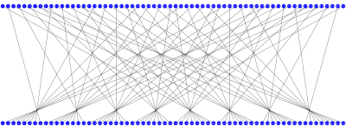
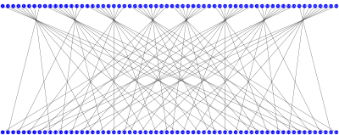
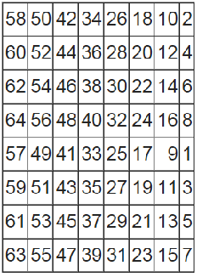
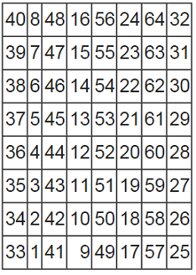





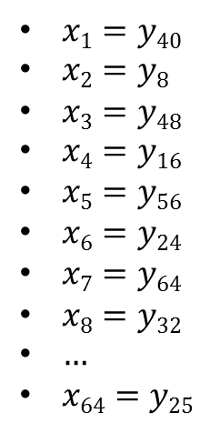
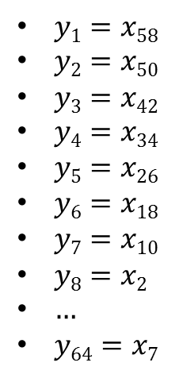

Initial Permutation IP
$$x=x1x2x3⋯x64$$
$$y=y1y2y3⋯y64$$
$$y=y1y2y3⋯y64$$
$$x=x1x2x3⋯x64$$
$$IP$$
$IP^{−1}$
$y1=x58$
$y2=x50$
$y3=x42$
$y4=x34$
$y5=x26$
$y6=x18$
$y7=x10$
$y8=x2$
$…$
$y64=x7$
$x1=y40$
$x2=y8$
$x3=y48$
$x4=y16$
$x5=y56$
$x6=y24$
$x7=y64$
$x8=y32$
$…$
$x64=y25$

Slide 8

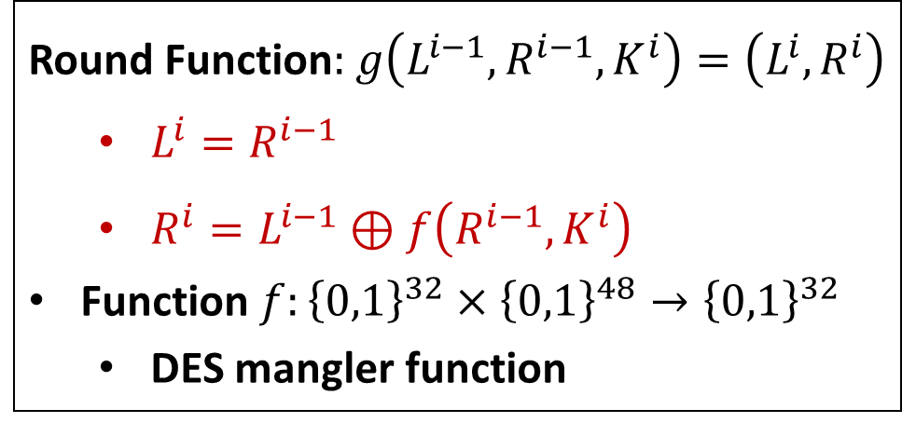
$$g(L^{i−1},R^{i−1},K^{i})$$
32 bits
32 bits
$$L^{i−1}$$
$$R^{i−1}$$
Round Function$:$ $g\left(L^{i−1},R^{i−1}, K^{i}\right)=\left(L^{i},R^{i}\right)$
$L^{i}=R^{i−1}$
$R^{i}=L^{i−1}⊕f\left(R^{i−1}, K^{i}\right)$
Function $f:{\left\{0,1\right\}}^{32}×{\left\{0,1\right\}}^{48}→{\left\{0,1\right\}}^{32}$
DES mangler function
$$f$$
$$K^{i}$$
48 bits
$$L^{i}$$
$$R^{i}$$
32 bits
32 bits

Slide 9
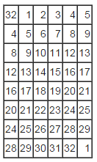
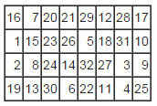
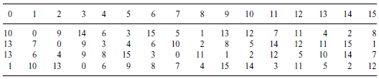





















The DES Mangler FunctionDES变形函数
$$32 bits$$
$$48 bits$$
$R^{i−1}$
$K^{i}$
$$E$$
$$48 bits$$
$$P$$
$$⊕$$
$$48 bits$$
$E$/ expansion function
$$S1$$
$$S2$$
$$S3$$
$$S4$$
$$S5$$
$$S6$$
$$S7$$
$$S8$$
$$32 bits$$
$$P$$
$$S3$$
$$f(R^{i−1},K^{i})$$

Slide 10

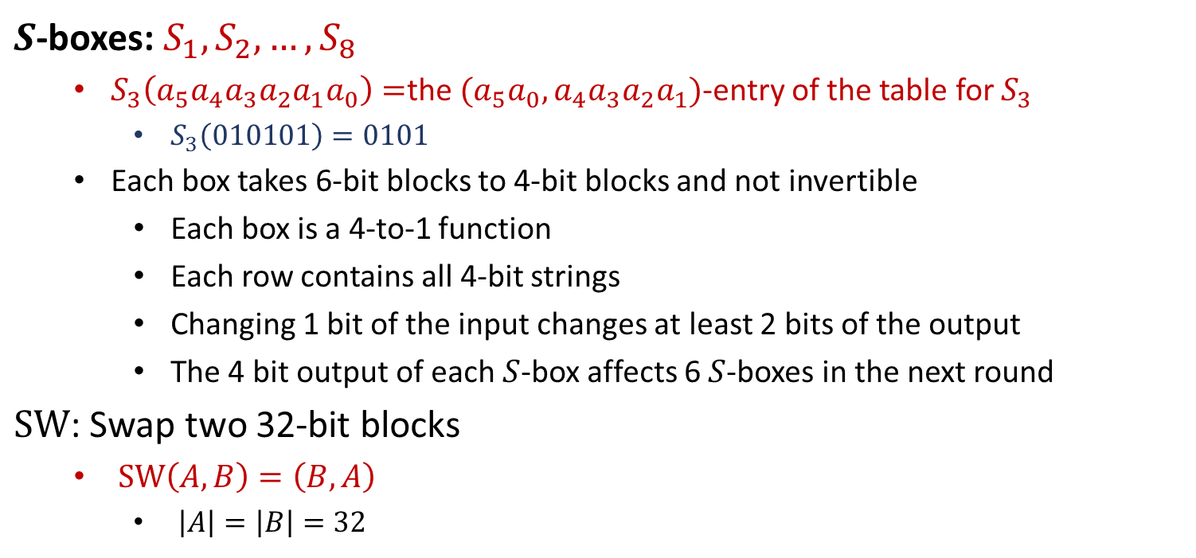
$S$-Boxes and $SW$
$S$-boxes: $S_{1}, S_{2},…,S_{8}$
$S_{3}\left(a_{5}a_{4}a_{3}a_{2}a_{1}a_{0}\right)=$the $(a_{5}a_{0},a_{4}a_{3}a_{2}a_{1})$-entry of the table for $S_{3}$
$S_{3}\left(010101\right)=0101$
Each box takes 6-bit blocks to 4-bit blocks and not invertible
Each box is a 4-to-1 function
Each row contains all 4-bit strings
Changing 1 bit of the input changes at least 2 bits of the output
The 4 bit output of each $S$-box affects 6 $S$-boxes in the next round
$SW$: Swap two 32-bit blocks
$SW\left(A,B\right)=\left(B,A\right)$
$\left|A\right|=\left|B\right|=32$

Slide 11
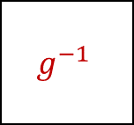

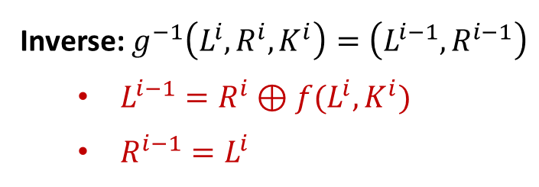



DES Decryption
$56$-bit
secret key $K$
key schedule
$48$-bit
$$K^{1}$$
$$K^{2}$$
$$⋯$$
$$K^{16}$$
$$g^{−1}$$
$$g^{−1}$$
$$g^{−1}$$
$$x$$
$${IP}^{−1}$$
$$⋯$$
$$IP$$
$$SW$$
$$y$$
$$L^{0},R^{0}$$
$$L^{1},R^{1}$$
$$L^{2},R^{2}$$
$$L^{16},R^{16}$$
$64$-bit
$64$-bit
Inverse: $g^{−1}\left(L^{i},R^{i}, K^{i}\right)=\left(L^{i−1},R^{i−1}\right)$
$L^{i−1}=R^{i}⊕f(L^{i},K^{i})$
$R^{i−1}=L^{i}$

Slide 12
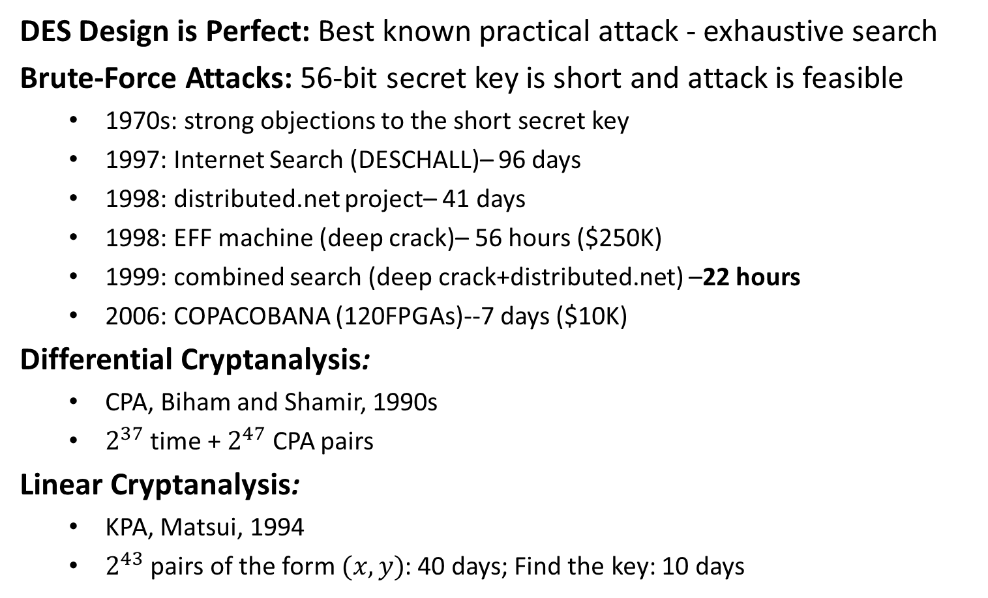
The Security of DES
DES Design is Perfect: Best known practical attack - exhaustive search
Brute-Force Attacks: 56-bit secret key is short and attack is feasible
1970s: strong objections to the short secret key
1997: Internet Search (DESCHALL)– 96 days
1998: distributed.net project– 41 days
1998: EFF machine (deep crack)– 56 hours ($250K)
1999: combined search (deep crack+distributed.net) –22 hours
2006: COPACOBANA (120FPGAs)--7 days ($10K)
Differential Cryptanalysis:
CPA, Biham and Shamir, 1990s
$2^{37}$ time + $2^{47}$ CPA pairs
Linear Cryptanalysis:
KPA, Matsui, 1994
$2^{43}$ pairs of the form $(x,y)$: 40 days; Find the key: 10 days
Differential Cryptanalysis was known
when it was designed in 1970s!
The method was kept secret for 20 years
until Biham and Shamir rediscover it.
Export of Cryptographic algorithms and devices
is strictly prohibited in US until 1992.

Slide 13
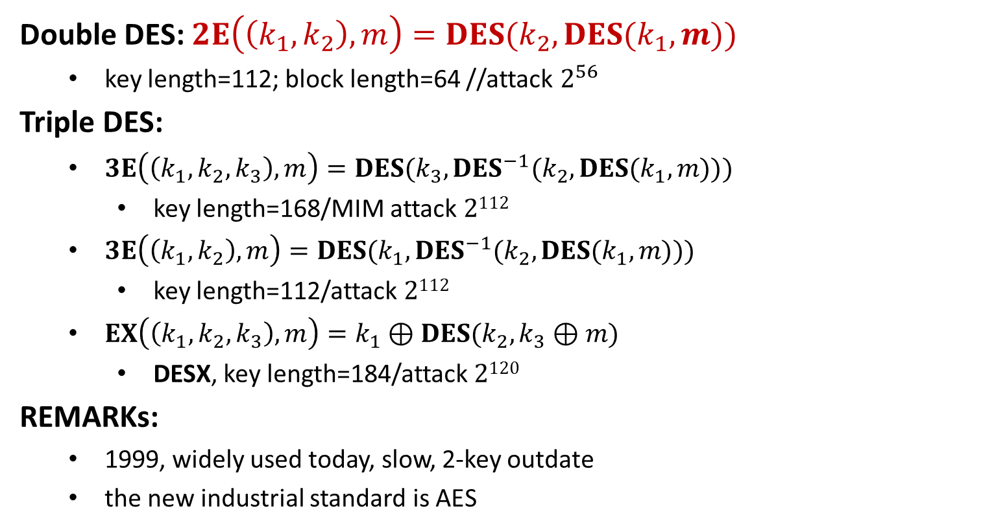
DES as a Block Box
Double DES: $2E\left(\left(k_{1},k_{2}\right), m\right)=DES(k_{2},DES(k_{1},m))$
key length=112; block length=64 //attack $2^{56}$
Triple DES:
$3E\left(\left(k_{1},k_{2},k_{3}\right), m\right)=DES(k_{3},DES^{−1}(k_{2},DES(k_{1},m)))$
key length=168/MIM attack $2112$
$3E\left(\left(k_{1},k_{2}\right), m\right)=DES(k_{1},DES^{−1}(k_{2},DES(k_{1},m)))$
key length=112/attack $2112$
$EX\left(\left(k_{1},k_{2},k_{3}\right),m\right)=k_{1}⊕DES(k_{2},k_{3}⊕m)$
DESX, key length=184/attack $2120$
REMARKs:
1999, widely used today, slow, 2-key outdate
the new industrial standard is AES

